Slide 1
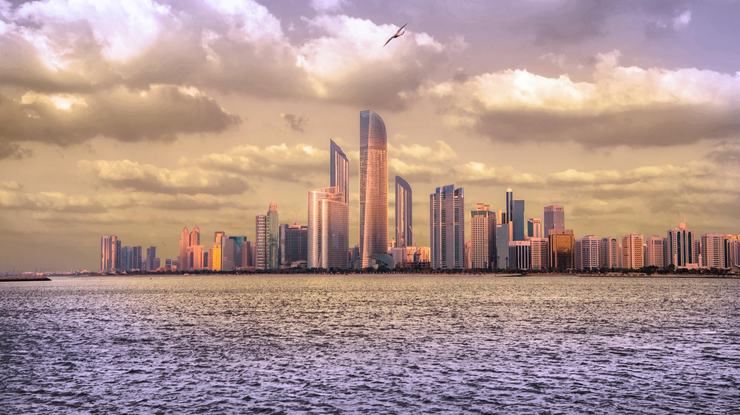

STRICTLY CONFIDENTIAL
DRAFT FOR DISCUSSION
INDUSTRIAL & LOGISTICS MEGAZONE
Strategic Opportunities
A structured assessment across seven themes — Abu Dhabi
APRIL 2026

Slide 2
CONTENTS
Contents
SECTION 1
SECTION 2
Context and objectives
Executive summary
A
B
SECTION 3
SECTION 4
Assessment of seven opportunities
Appendix
C
D
L'IMAD · Industrial Megazone Strategic Opportunities · April 2026
STRICTLY CONFIDENTIAL
02

Slide 3
A
SECTION 1
Objective and Approach
STRICTLY CONFIDENTIAL · DRAFT FOR DISCUSSION
03

Slide 4
A · OBJECTIVE AND APPROACH
DRAFT FOR DISCUSSION
A structured, data‑driven approach underpins opportunity identification and prioritisation for the Industrial Megazone
A
CONTEXT
THE SEVEN THEMES
The Megazone is a green manufacturing-first, logistics-integrated industrial platform spanning 200+ square km, designed to incubate the powerful but fragmented set of relevant assets across Abu Dhabi.
Health & Life Sciences
Maritime Industrial Base
As such, Battery Manufacturing and Recycling are assessed, along other themes, as potential strategic opportunities for Abu Dhabi's Industrial & Logistics Megazone.
Circular Economy
Critical Inputs & Storage
OBJECTIVES OF THIS DOCUMENT
This document supports the development of the Industrial Megazone by identifying opportunities for consideration across 7 themes , providing a longlist and shortlist for leadership.
Energy
Digital & Communications
A data‑driven screening framework, grounded in secondary research and expert validation, prioritises the most executable opportunities.
Advanced Manufacturing
MEGAZONE SYNERGIES ASSESSED
· Input material adjacency
· Demand and monetisation
· Cost efficiency
· Shared ecosystem
· System integration
· Broader Megazone synergies
Source: Internal analysis · L'IMAD opportunity framework v3.
STRICTLY CONFIDENTIAL
04

Slide 5
A · OBJECTIVE AND APPROACH
DRAFT FOR DISCUSSION
20+ opportunities were screened against 6 robust and equally‑weighted criteria, resulting in a focused shortlist of 7 opportunities
A
INITIAL UNIVERSE
SIX EQUALLY‑WEIGHTED CRITERIA
SHORTLIST · FOR CONSIDERATION
20+
01
02
7
UAE Strategic Alignment
Market Attractiveness
Operation 300 Bn, NetZero 2050, Falcon Economy, Food Security 2051
Size and growth
03
04
shortlisted opportunities across 7 themes
initial opportunities considered across 7 themes
L'IMAD Portfolio Synergies
Supply Chain Resilience
PortCos providing captive demand, infrastructure leverage and partnership pathways
Including diversification from China
▸
Pharmaceutical Distribution & Storage
▸
Specialty Chemicals & Industrial Gases
05
06
▸
Critical Minerals Processing & Refining
Financial Metrics
Execution Feasibility
▸
Semiconductor Advanced Packaging
Industry benchmark
IP licensability, talent, time-to-operationalise
▸
Battery Recycling
▸
Advanced Metals
▸
Food Storage and Cold Chain
Source: Internal framework and analysis. All criteria are equally weighted.
STRICTLY CONFIDENTIAL
05

Slide 6
C · EXECUTIVE SUMMARY
Shortlisting highlights top‑ranked opportunities within Health & Life Sciences, Critical Inputs & Storage, Digital & Communication, and Energy themes
C
#
THEME
OPPORTUNITY
RATIONALE
1
Critical Inputs & Storage
Specialty chemicals and industrial gases
Establishes the Megazone's chemical backbone yielding synergies with other opportunities; leverages TA'ZIZ infrastructure for structural cost advantage. International JV pathway already in feasibility (Air Liquide, Linde).
2
Critical Inputs & Storage
Critical minerals processing and refining
China‑diversification initiatives as Western customers actively seek non‑Chinese midstream capacity. Cluster‑anchor opportunity supporting Advanced Metals and Copper / Electrical Components.
3
Advanced Manufacturing
Advanced metals: magnets, specialty alloys and foundry
Specialty alloys serve adjacent sectors (e.g. ADNOC sour gas, duplex stainless). Low‑cost industrial power and geopolitical neutrality; EGA processing capability transferable, multiple licensing pathways.
4
Critical Inputs & Storage
Food storage and cold chain
Supports UAE food security through strategic storage of staples and perishables. Highly executable resilience platform with clear public and private demand; leverages port connectivity and local food anchors.
5
Health & Life Sciences
Pharmaceutical distribution and storage hub
Distribution-led positioning leverages UAE's logistics strengths; embeds emergency medical stockpile and pharma reserves. Fast execution 24‑36 month, multiple JV‑ready partners actively seeking MENA hub.
6
Digital & Communication
Semiconductor advanced packaging and ATP
Global whitespace, addresses industry need to reduce Taiwan concentration risk. Captive UAE demand from G42 / Stargate AI build‑out provides anchor offtake. GlobalFoundries (Mubadala) provides established UAE‑semiconductor relationship.
7
Energy
Battery recycling and black mass processing
Creates circular value with recovered minerals feeding critical mineral processing. Regional EV deployment and stationary storage build‑out will create black mass supply. Mature, IP licensable from multiple potential partners.
Source: Internal framework and analysis. Indicative entities operational in or linked to UAE — not confirmed anchor commitments. Includes ADQ portfolio, broader UAE sovereign entities, and international targets.
STRICTLY CONFIDENTIAL
06

Slide 7
B
SECTION 2
Assessment of seven opportunities
STRICTLY CONFIDENTIAL · DRAFT FOR DISCUSSION
07

Slide 8
1
OPPORTUNITY #1 · HEALTH & LIFE SCIENCES
Pharmaceutical Distribution & Storage
A distribution‑led pharma hub leveraging Etihad CEIV cargo, KEZAD cold‑chain corridor, and the 2026 multi‑distributor mandate.
STRICTLY CONFIDENTIAL · DRAFT FOR DISCUSSION
08

Slide 9
HEALTH & LIFE SCIENCES · OPPORTUNITY #1
PRELIMINARY AND DIRECTIONAL
A world‑class pharma cold chain allows the Megazone to win in pharma distribution without competing on drug manufacturing
1
Research & Discovery
Manufacturing
Distribution
Lifecycle Management
Biology, chemistry, genomics
Raw materials, formulation, packaging
Wholesale, pharmacies and hospital systems
Pharmacovigilance, follow‑on trials
$2025
+10% CAGR
$2025
+6% CAGR
$2025
+7% CAGR
$2025
Global landscape: Dominated by countries with strong medical research; USA most advanced, China fast growing.
+7% CAGR
Global landscape: Fragmented; patent extension, brand loyalty.
Global landscape: Concentrated supply; product complexity and scale dominate.
Global landscape: Fragmented; cold-chain infrastructure (KEZAD), air freight (Etihad) advantage.
Profit drivers: Data platforms and outcome tracking — but very small market.
Profit drivers: IP strength & defensibility, clinic success, speed to market.
Profit drivers: Product complexity, manufacturing scale.
Profit drivers: Market access, scale, product mix, channel control.
LOW FIT
INDIRECT OPPORTUNITY
FOCUS OF ASSESSMENT ▸
LOW FIT
STRATEGIC FIT FOR L'IMAD / UAE
Distribution leverages UAE infrastructure (Etihad cargo, KEZAD cold corridor). Manufacturing constrained by destination‑country regulations and small local market — partial leverage of UAE pharma champions Neopharma, Arcera, Julphar. Research is long‑timeline; PureHealth‑led Abu Dhabi Health Research Centre partnership model applies.
Source: Internal Analysis, IEA, IRENA, Mordor Intelligence, GrandView Research, Research and Markets, Business Research Insights, Cognitive Market Research, Yahoo Finance, Press search. 1. Market size estimates triangulated from multiple market research and industry reports. 2. Destination‑country regulations could constrain global distribution.
STRICTLY CONFIDENTIAL
09

Slide 10
PHARMA · DISTRIBUTION SEGMENTS
PRELIMINARY AND DIRECTIONAL
Four distribution segments map onto three potential UAE plays — generics gateway, multimodal hub, and biologics anchor
1
SEGMENT
SHARE % G | R | UAE
MATURITY
UAE PROS
UAE CONS / PLAYS
Originator Manufacturers Branded pharma manufacturers
45% | 25% | 7%
Mature; MNCs consolidating regional hubs. Nascent in AD; Dubai‑dominant.
GSK / Rafed proof of concept; HELM life sciences cluster; direct access to SEHA / PureHealth.
Abu Dhabi pharma ecosystem still nascent. Short‑Medium Term Play, declining TAM.
Generic Manufacturers Off‑patent small‑molecule producers
35% | 15% | 10%
Highly competitive; Indian dominant on cost; EU consolidating; favourable CEPA potential.
Khalifa Port — shorter Indian Ocean transit; 90‑day MOHAP fast‑track; PHARMEXCIL‑endorsed gateway.
UAE high‑cost for price‑sensitive generics; no Tatmeen serialisation yet. India‑GCC Re‑Export Gateway Play.
Global Third‑Party Operators Asset‑heavy multi‑client logistics
50% | 25% | 10%
Fast‑growing; consolidating via M&A; cold‑chain complexity drives outsourcing. UAE well‑positioned as MEA gateway.
ADPG dual EU+WHO GDP cert enables EU re‑export; Etihad CEIV Pharma + airside‑to‑KEZAD cold corridor; large land bank.
Client base not yet here. Next‑Generation Multimodal Pharma Hub.
Distributors & Agents Licensed importers, channel distributors
40% | 30% | 15%
Mature globally; UAE/GCC consolidating; players evolving into market access & regulatory services.
2026 multi‑distributor mandate = forced AD entry; strong AD public healthcare demand; duty‑free re‑export to KSA, Kuwait, Oman, Qatar, East Africa, CIS.
Less existing retail pharmacy / private hospital networks. Anchor MNC biologics hubs (Roche, Novartis, AZ).
UAE REFERENCE FACILITY
UAE REFERENCE FACILITY
UAE REFERENCE FACILITY
COLD‑CHAIN PREMIUM VS AMBIENT
Sources: IMARC; Mordor Intelligence; Alira Health; Technavio; GMI; Grand View Research; ResearchAndMarkets; Precedence Research; Fortune Business Insights; Statista; IQVIA; WHO; World Bank; JLL; Knight Frank; CBRE; Frost & Sullivan; McKinsey; Deloitte; PwC.
Ambient 1.0× · Cold 1.4–1.6× · Frozen 2.0–2.5× · Deep frozen 3.5–5.0×
GSK Vaccine Hub, AD
Kuehne+Nagel, Dubai South
MPC Healthcare, DWC
2,000 m² · -80°C to +25°C · 60,000 pallets
40,000 m² · 2–8°C cold chain · 50,000 pallets
14,600 m² · cold chain + frozen · 17,000 pallets
STRICTLY CONFIDENTIAL
10

Slide 11
3
OPPORTUNITY #3 · CRITICAL INPUTS & STORAGE
Critical minerals processing and refining
Cluster‑anchor opportunity supporting Advanced Metals; addresses China‑diversification demand from Western customers seeking non‑Chinese midstream capacity.
STRICTLY CONFIDENTIAL · DRAFT FOR DISCUSSION
11

Slide 12
CRITICAL INPUTS & STORAGE · OPPORTUNITY #3
PRELIMINARY AND DIRECTIONAL
Locating critical minerals smelting and refining plant in the Megazone enables the UAE to anchor a durable role in the global critical‑minerals value chain
3
Exploration / Mining
Beneficiation
Smelting & Refining
Advanced Materials
Recycling / Recovery
Upstream — Ore extraction (Li, Co, Ni)
Midstream — Concentration (crushing, grinding)
Midstream — High‑purity output
Downstream — Magnets, alloys
Black mass, scrap, e‑waste
$2025
+6%
$2025
+21%
$2025
+15%
$2025
+5%
$2025
+12%
IP and tech credentials, OEM lock‑in.
Feedstock‑dependent ; feedstock import, low regional volumes, hydrometallurgy.
Resource rent contracts — structural but cyclical.
Scale‑driven, energy intensive ; typically co‑located with mine‑site.
China share 80–90% ; Indonesia (nickel) >60%.
Materials supply, Megazone synergies, regional logistics hub.
Leverage IRH, Orion JV, G2G deals (Pax Silica, USA, Argentina, DRC, Zambia).
Equity plays, not domestic build.
Energy advantage, EGA processing DNA. Neutral between China processing & Western reshoring.
Regional logistics hub.
INDIRECT
LOW FIT
FOCUS ▸
INDIRECT
INDIRECT
Minerals considered for refining have been aligned with (1) feedstock accessibility and (2) requirements for potential advanced‑materials foundries . China's share of global midstream output exceeds 50% across most commodities — UAE positioning aims to capture non‑China premium.
STRATEGIC FIT FOR L'IMAD / UAE
Source: Internal Analysis, IEA, IRENA, Mordor Intelligence, Markets&Markets Research, IntelMarketResearch, GrandView Research, Fortune Business Insights, Precedence Research, Yahoo Finance, Press search. 1. Estimates triangulated. 2. Critical mineral processing equipment used as proxy. 3. Rare earth magnets used as proxy. 4. Battery recycling used as proxy.
STRICTLY CONFIDENTIAL
12

Slide 13
CRITICAL MINERALS · REFINING STRATEGY
PRELIMINARY AND DIRECTIONAL
Partnerships and equity investments unlock a long‑term strategic critical‑minerals platform across copper, rare earths, cobalt, and lithium
3
MINERAL
DOMINANT APPLICATION
SHARE G | R | UAE
PROS
CONS
UAE PLAY
Copper (Cu) Mature; bullish capacity signals
Power Grids · EVs · Construction · Datacentres
48% | 8% | 6%
Largest market with structural deficit projected by 2035; strong AI/datacentre demand; Mopani strategic supply anchor.
Cost disadvantaged to DRC and China; negative refining margins 2025–2026.
Expand Partnerships for Regional Anchor Refinery. Plan cathode refinery for post‑2030 commissioning.
Rare Earths (REE) China‑dominant; diversification underway
Magnets (EV, wind, defense) · Catalysts · Polishing
90% | 5% | 2%
Highest non‑China premium of any critical mineral; fastest path to materiality with reduced CAPEX exposure; multiple intl. policy programmes.
Complex multi‑stage separation, history of CAPEX overruns; China retaliation tools (price, technology, licensing).
Capture Premium via Equity First, Then Refinery. Sequence small‑scale NdPr refinery post‑2028.
Cobalt (Co) Mature, supply‑tight
NMC Cathodes · Superalloys (Aerospace) · Magnets
79% | 9% | 3%
Capital‑efficient with multi‑application optionality; growing demand for black‑mass recycling.
Extreme price volatility (-80% peak‑to‑trough 2022–24); DRC concentration risk (>70% of mined supply).
Build via Recycling and Equity. Target battery‑grade sulphate refinery post‑2030 once non‑China premium sustained.
Lithium (Li) Growing; oversupply clearing
LFP Carbonate · NMC Hydroxide · Glass · Greases
65% | 16% | 5%
Long‑term EV and energy‑storage demand growth; downstream integration optionality with UAE battery ambitions.
Structurally disadvantaged on costs to brine producers; established players have faced material execution risks.
Develop Partnerships, Defer Refinery FID post‑2027. Study LCE conversion via spodumene or DLE.
UAE REFERENCE PLANT
Cu 300–500 kt/yr · USD 1.0–1.8 Bn · 5,000–7,500/t
REE 5 NdPr / 15 REO · USD 1.0–1.5 Bn · 4,500–7,000/t
Co 10 kt/yr · USD 0.7–1.1 Bn · 4,000–6,000/t
Li 25 LCE · USD 1.0–1.5 Bn · 3,000–5,000/t
Sources: IEA Global Critical Minerals Outlook 2025, S&P Global, BloombergNEF, Wood Mackenzie, Global Cu Smelter & Refinery Cost Summary Q4 2025, Cobalt Institute Market Report 2024, Company disclosures, Media articles. UAE estimates assume Gulf construction premium +25–40% vs. Chinese benchmark, partly offset by lower power / labour costs. Refining cash costs are 2025 estimates net of byproduct credits.
STRICTLY CONFIDENTIAL
13

