Slide 1







Ultimate Pitch Deck & Charts Kit
Aura Inc.
Ground Floor 1-2 Craven Road, London, W7 2UA, UK
www.aura.com
101 Switzerland Fintech Companies
75 Best New York Startups

Slide 2









The market
Digital Banking Market Growth
The Opportunity
We operate in a rapidly expanding market. The global digital banking sector is projected to grow at a 10% CAGR, surpassing $1.7 trillion by 2026. This creates a massive opportunity for innovation.
Values in $ billions
Today’s users demand seamless, mobile-first experiences with a high degree of personalization. They expect financial services to be integrated directly into the platforms they use every day. This creates a unique window of opportunity for businesses: by embedding financial products, you can capture new revenue streams, create a much 'stickier' ecosystem, and dramatically increase customer lifetime value (LTV).
CAGR 10%
1,902.40
1,766.38
1,623.98
1,594.53
1,476.84
The Challenge
1,281.92
1,369.86
803.80
984.18
The main challenges that businesses face once decided to create own branded Neobank include the following:
Navigating complex licensing and regulatory requirements.
Hiring and retaining specialized engineering teams.
Building secure financial infrastructure from scratch.
A slow go-to-market timeline that misses opportunities.
2018
2019
2020
2021
2022
2023
2024
2025
2026
Users Growth
Users in
2019
1.5B
The user base for digital banking is exploding. By 2024, the number of users is set to exceed 3.6 billion—a 54% increase from 2020.
Users in
2024
3.2B
Platform Overview
02

Slide 3
Numbers that speak for themselves
active users across 15 countries
monthly transaction volume
customer satisfaction score
Just a few years, we’ve grown from a bold idea into a financial platform trusted by millions. Today, we process over $3.7 billion in payments every month, helping individuals and businesses send, spend, and manage their money with ease — across borders and currencies.
Our product is fast, intuitive, and reliable — and our customers notice. With an average app rating of 4.9 out of 5 and a 92% referral likelihood, user satisfaction is at the heart of our growth.
What makes this possible? A relentless focus on infrastructure, security, and simplicity — ensuring that every tap, swipe, and transfer happens instantly and without friction.
2M+
$3.2B
98%
average transaction processing time
last year revenue
total amount of registered users
< 1 sec
$0.9B
11M+
Platform Overview
03

Slide 4
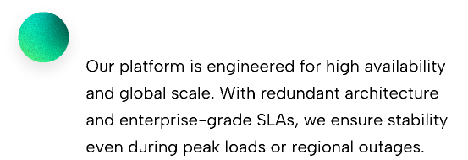
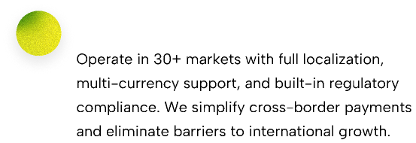
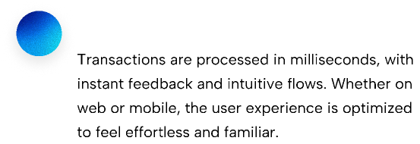
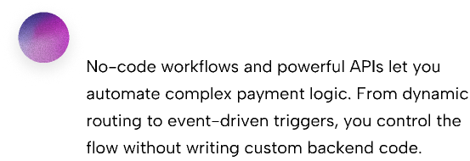
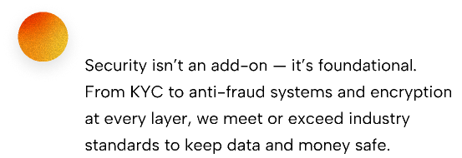
What makes us different
Platform Overview
04

Slide 5

Aura’s platform allowed us to launch branded debit cards for our Helio app in a matter of weeks.
Mark Levin
CEO of Helio

Slide 6
Consistent growth
The last ten months have been a period of significant acceleration for the Aura platform. We're seeing powerful, compounding growth, with key platform metrics up by over 150% year-over-year. This isn't just about acquiring new partners; it's about growing with them.
The first chart illustrates our momentum in new business acquisition, showing a 45% quarter-over-quarter growth in new partners joining the platform.
This is a direct result of market trust in our technology and shows that more companies are choosing Aura as their foundational infrastructure for launching financial products.
The second chart tells an equally important story: the success of our existing partners. Transaction volume from this cohort has surged by over 300%, demonstrating strong end-user adoption.
As they succeed, we succeed. This dynamic has pushed our net dollar retention to an industry-leading 140%, creating a powerful network effect that fuels sustainable, long-term growth.
$71
$159
$122
$71
$122
$159
Apr
May
Jun
Apr
May
Jun
Platform Overview
06

Slide 7
Total Revenue
($ Millions)
Platform Fees (MRR)
Transactional Revenue
$100
$248
$250
$224
$208
$205
$130
$193
$200
$128
$168
$170
$139
$150
$122
$132
$152
$148
$124
$110
$140
$70
$159
$122
$140
$125
$70
$100
$20
$71
$170
$140
$120
$50
$60
$60
$72
$81
$52
$34
$48
$39
$32
$28
$25
Q1'24
Q2’24
Q3'24
Q4'24
Q1'25
Q2'25
Q3’25
Q4’25
Q1’26
Q2’26
Q3’26
Q4’26
Q1’27
Q2'27
Q3'27
Platform Overview
07

Slide 8

Sources of New Revenue (Q1'24)
($ Millions)
Expansion Revenue
Revenue from New Customers
$70
$70
$70
$50
$50
$50
$20
$20
$20
$20
$20
$20
Q1'24
Q1'24
Q1'24
Platform Overview
08

Slide 9

IBAN / ACH accounts
Send and load money worldwide
Plastic and virtual cards
Detailed history
Platform Overview
09

Slide 10

Implementation Timeline
1
2
3
4
5
6
7
8
9
10
Accelerated Launch: Our goal is to get your product to market in record time. This typical 10-week timeline shows a collaborative path from initial concept to public launch.
Approach: Each phase is a close partnership. Our dedicated success managers work with you through technical integration, compliance checks, and beta testing.
Brand Foundation
Brand Identity
Brand Guidelines
Brand Assets
Holiday
Copywriting + Web Design
Quick Wins
Web Development
Release & Support
Platform Overview
10

Slide 11
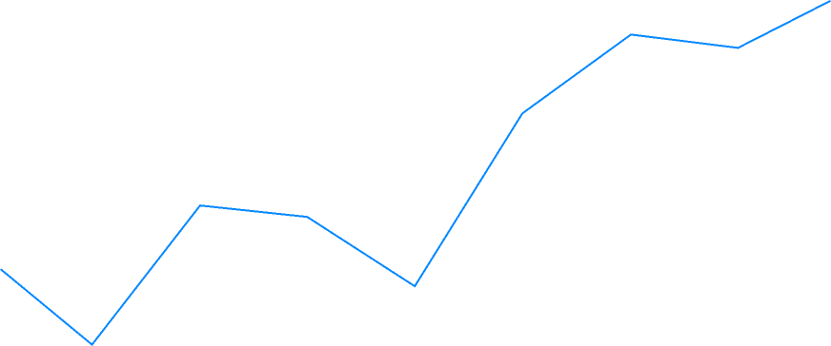
Cross-border payments in motion
100%
80%
Enable your users to connect with the global economy. International payments are a key growth driver, from paying overseas freelancers to managing global teams and sending money home. Our platform is designed to handle the natural ebbs and flows of cross-border activity, which often fluctuates due to seasonality, regional events, and user behavior. We manage this complexity so you don't have to.
60%
40%
For your customers, what matters isn't just volume — it's reliability. Our robust infrastructure and global network ensure that, regardless of transaction patterns, every international payment is fast, fully traceable, and cost-effective.
20%
0%
Aug
Sep
Oct
Nov
Dec
Jan
Feb
Mar
Apr
Platform Overview
11

Slide 12
Build What Customers Demand
The gap between customer expectations and what traditional banks offer has never been wider. Slow, branch-based processes, hidden fees, and limited functionality are no longer acceptable in a digital-first world. To compete and win, you need to offer a fundamentally better experience.
The table on the left shows the new standard. With Aura, you can build and launch a neobank that delivers this exact level of service out of the box. Our platform provides the core technology to enable features like 5-minute onboarding, 24/7 in-app support, and built-in spending analytics. We empower you to create the modern, frictionless banking experience your customers demand.
Platform Overview
12

Slide 13










Company Structure
London, UK
Estonia, Tallinn
Finance
Research and development
Operational Parent company and headquarter (holds ultimate rights to all IP and receives the majiority of profits from subsidiaries)
New York, USA
Business Development
Zug, Switzerland
Headquarters
B2B Marketing & Sales entity for SaaS Products (not requiring regulatory licenses)
Sales entity providing Digital Banking and Payment Gateway Services
Platform Overview
13

Slide 14










The people building your next bank
Lucas Meyer
Jasper Lee
Nina Carvalho
Daniel Novak
Tanya Feldman
CEO & Co-Founder
CTO
Head of Product
Lead Backend Engineer
Design Lead
Ex-Wise. Scales fast-moving teams with a product-first mindset.
Built infrastructure for 10M+ users. Security is his second nature.
Previously at Nubank. Obsessed with clean UX and smart flows.
API magician. Builds systems that never break under pressure.
Turns complexity into clarity. Formerly at Klarna & Dropbox.
Sophie Laurent
Leo Haddad
Mateo Díaz
Isabella Chen
Arman Petrosyan
Head of Growth
Head of Partnerships
Payments Infrastructure
Customer Experience Lead
Head of Compliance
Grew two fintechs to 7-figure MRR. Data is her playground.
Connects us to platforms, merchants, and ecosystems.
Knows everything about global rails. From SEPA to PIX.
Makes support feel like a feature. Loved by users.
Keeps us fast, legal, and future-proof. EU & UK licensed expert.
Platform Overview
14

Slide 15




Marketing,
Business Development
Working capital
(including HR)
Investment Offering
Series A Round
..........................................................................
USD 5.6M
Company valuation
..............................................................
USD 30M
Use of Series A Proceeds
Total equity stake offered
..........................................................................
19% in treasurу shares
.................................................
Investment Type
..........................................................................
Equity or Convertible Debt
Minimum Tranche
..........................................................................
$500,000
Strategic,
Technology Acquisition
Platform Overview
15

Slide 16



Contact
Optherium is a global technology services & proprietary products provider for banks and large enterprises. We help our clients unlock transformative value through technology-enabled opportunities.
Baarerstrasse 190, 7200 Zug, Switzerland
Ground Floor 1-2 Craven Road, London, W7 2UA, UK
20 Wall St, 7th Fl, Suite 726 New York, NY 10005, USA
4 Aia, 2ndFl, Suite 16, Tallinn, 10111, Estonia
Website: optherium.com
Email: info@optherium.com
Phone: +1 2125379492
16

